Slide 1
Smart Energy Management and Load Optimization for Commercial Microgrid Systems
Team Members:
M. Ahmed Hussain (427781)
Fatima Hassan
Abdul Haseeb Zahid (432219)
Supervisors:
Dr. Zaki Ud Din (University)
Sir Mustafa Aziz (Industry)

Slide 2
Introduction to Project
• Growing reliance on solar power and need for efficient energy usage.
• HVACs & ACs contribute significantly to commercial energy consumption.
• Our project integrates real-time inverter communication, intelligent load management, and smart monitoring.

Slide 3
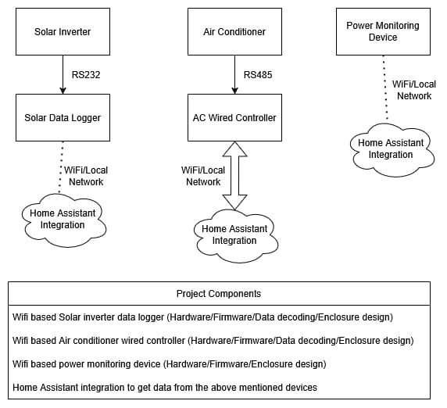
Early System Design Pictorial View

Slide 4
Deliverables
Data Acquisition from multiple solar inverters for real-time data (PV, grid, battery, load).
Communication and Actuation of critical loads (HVACs, ACs).
Custom Home Assistant integration for monitoring and decision-making.
Smart load management (full automation + user control).
Power monitoring node (device/room/house level).

Slide 5
Work Distribution
Member | Responsibility
Abdul Haseeb Zahid | Inverter communication module (data extraction & protocol handling)
Fatima Hassan | Home Assistant integration, UI/UX, automation rules
M. Ahmed Hussain | HVAC/AC communication & control, hardware interfacing, system integration

Slide 6
Current Progress
Member | Progress
Abdul Haseeb Zahid | Research on inverter communication protocols (Modbus/RS232/RS485)
Fatima Hassan | Literature review on load management & Home Assistant integration
M. Ahmed Hussain | Initial system architecture design, ESP controller setup trials

Slide 7
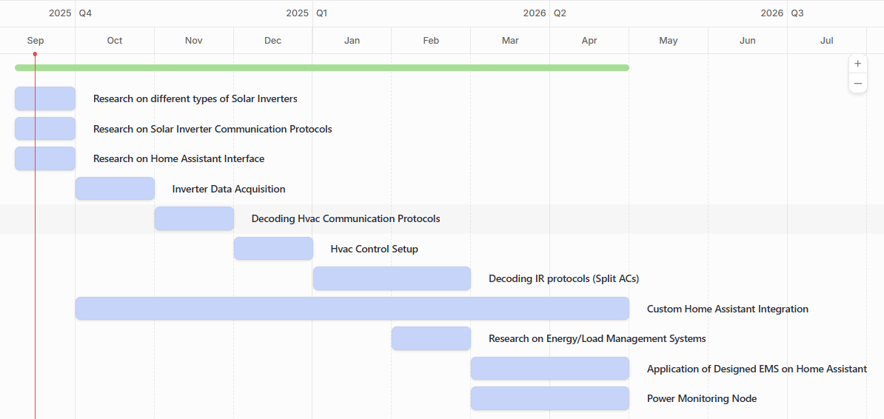
Gantt Chart

